Slide 1
INTRODUCTION
What to learn

Slide 2
What are we doing today?
Why design our apps?
Stages of app design
Benefits of app design

Slide 3
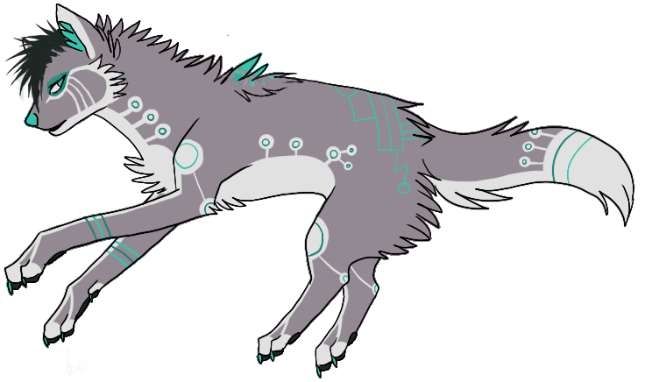
Need help?
Github:
http://www.github.com/webdevelopwolf/training
Twitter:
http://www.twitter.com/webdevelopwolf
Facebook:
http://www.facebook.com/webdevwolf

Slide 4
APPLICATION DESIGN
Those who fail to plan…

Slide 5
WHY CAN’T WE JUST GET STRAIGHT IN THERE AND START CODING???
A mobile app is released on iOS or Android at least 8 times a day.
Most global corporations have their own apps and development teams to match their size
Apple monitor application quality and control the content on their own store
There’s a high amount of pressure to ‘get it right first time’

